Slide 1
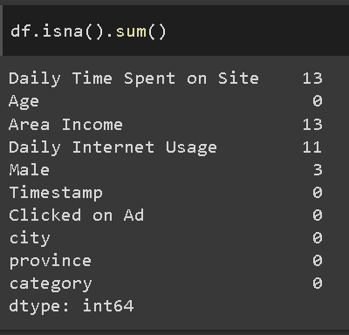
Data Cleaning & Preprocessing
There are 13 missing values in the Daily Time Spent on Site column, 13 missing values in the Area Income column, 11 missing values in the Daily Internet Usage column, and 3 missing values in the Male column, out of about 1000 rows. Since the number of missing values is relatively small (<5%), we drop them.
For more details, see jupyter notebook here

Slide 2
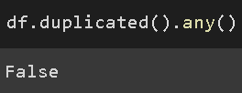
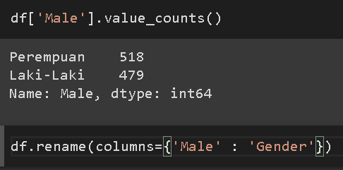
Data Cleaning & Preprocessing
No duplicate data found in the dataset.
There is an inappropriate column naming. The male column contains the user's gender data and renamed the column to gender.
For more details, see jupyter notebook here

Slide 3
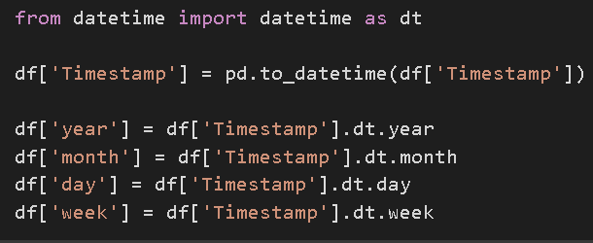
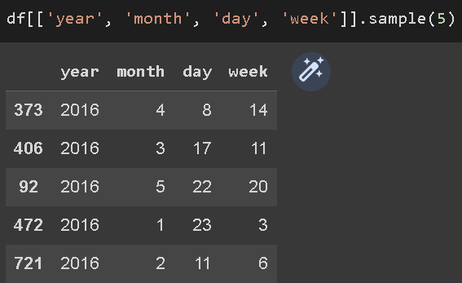
Data Cleaning & Preprocessing
feature engineering is also done to extract the year month week and date data in the Timestamp column to be used as a feature in the ML model.
For more details, see jupyter notebook here

Slide 4
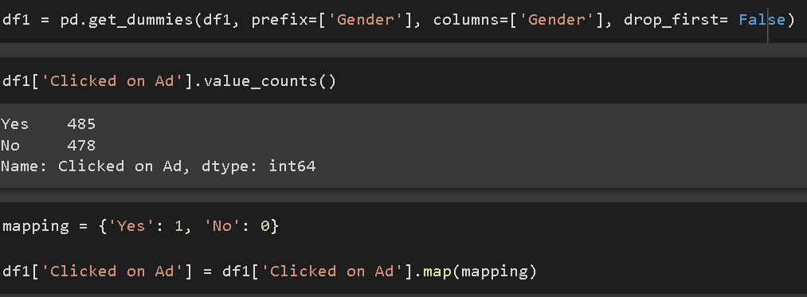
Data Cleaning & Preprocessing
feature encoding is also done to convert category data in the gender and Clicked on Ad column into numeric data so that it can be used in ML modeling.
For more details, see jupyter notebook here

Slide 5
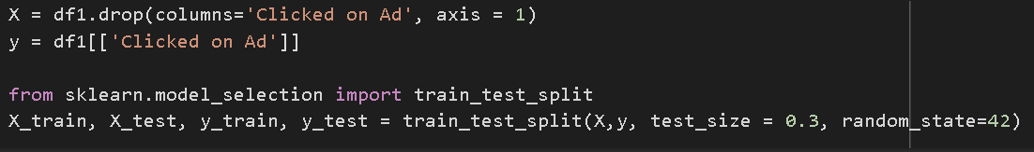
Data Cleaning & Preprocessing
Split the data into 2, namely data from the columns that will be used as features, and target data containing ads_click. Then select the feature and split the data into train data and test data with a ratio of 70:30.
For more details, see jupyter notebook here

